Slide 1




OPCM: Opportunistic Performance-driven Connectivity Management for 5G/xG Networks
CoNEXT'25 Hong Kong
Ahmad Hassan, Wei Ye, Anlan Zhang, Rostand A. K. Fezeu, Jason Carpenter, Ruiyang Zhu, Shuowei Jin, Myungjin Lee, Akshay Jajoo, Morley Mao, Zhi-Li Zhang, Feng Qian
Presenter: Ritvik Janamsetty
Notes:
Thanks for the introduction.
Hi everyone, my name is Ritvik Janamsetty, and I’m from the University of Southern California, and today I’ll be presenting our work on OPCM — Opportunistic Performance-driven Connectivity Management for 5G and beyond. This is joint work led by my colleague Ahmad Hassan with collaborators from USC, the University of Minnesota, the University of Michigan, and Cisco Research. At a high level, our question is simple: in today’s world of 4G, 5G, and the future potential of 6G, with lots of different cells and architectures, how should the network actually decide which cells your phone should be on to get the best performance, not just a “good enough” signal?
[click]

Slide 2
Evolution of Cellular Technologies
1980s
1990s
2000s
2010s
2020s
2030s
1G
2G
3G
4G
5G
6G
LowBand frequencies for voice-only calls.
Text messaging and basic data services.
MidBand and packet-switched data.
Carrier aggregation and high-speed broadband.
mmWave, NSA/SA modes, and low-latency communication.
Ubiquitous connectivity, AI-centric, and energy efficiency.
Notes:
To understand why we built OPCM, Let me start with a brief look at how we got here.
[click] Back in the 80s with 1G, we only had analog voice calls. 2G brought us text messages, 3G packet-switched data, and then 4G finally brought us the ubiquitous high-speed mobile connectivity we all use today.
[click] 5G pushes further with diverse architectures like Non-Standalone (NSA) and Standalone (SA) modes and a massive range of frequencies from low-band to mmWave. And 6G is anticipated to build on this, pushing us toward smarter, performance-driven connectivity.
However, as the radio side becomes far more diverse and dense, our connectivity management (or CM) is still rooted in older, link-quality-based methods.
[click]

Slide 3

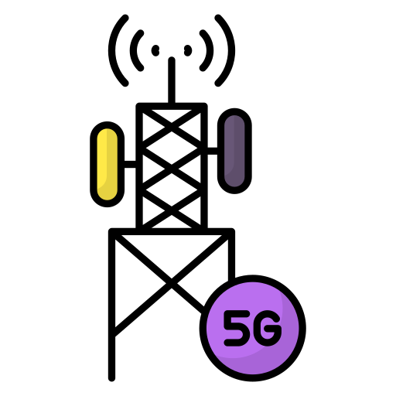
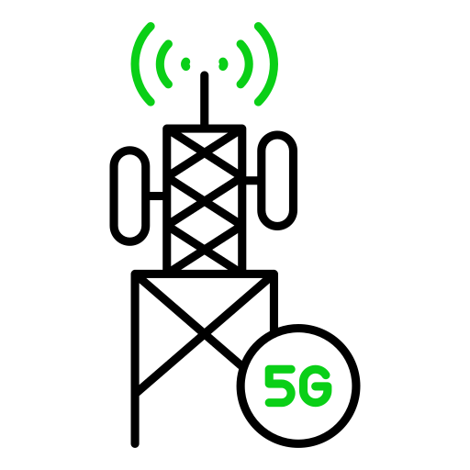




which cell/s should be selected to serve a user
Connectivity Management (CM) Procedures
measure
signal quality
Cell Selection
Notes:
This growing mismatch creates a fundamental challenge: with so many possible cells and cell combinations, which one should a user actually be served by?
[click] Today, that question is handled by a fragmented set of connectivity-management procedures. So next, let’s zoom in on how these mechanisms actually work.
[click] The most basic operation is cell selection. This happens when a User Equipment, often abbreviated or UE, such as a mobile phone, scans neighboring cells when you turn it on and
[click] camps on one of them.
[click]

Slide 4

which cell/s should be selected to serve a user
Connectivity Management (CM) Procedures
measure
signal quality
Cell Selection
Cell Reselection
Notes:
[click] Then, if the UE moves while it is idle, meaning not sending or receiving any data
[click] Cell Reselection kicks in to find a better tower.
[click]

Slide 5

which cell/s should be selected to serve a user
Connectivity Management (CM) Procedures
measure
signal quality
Cell Selection
Cell Reselection
Handover
data forwarding
Notes:
[click] If instead the UE moves while there is some sort of data activity (that can be interrupted momentarily) a Handover occurs.
[click] When the UE connects to a new base station during a Handover, its data might need to be forwarded to keep the session alive.
[click]

Slide 6
which cell/s should be selected to serve a user
Connectivity Management (CM) Procedures
Cell Selection
Cell Reselection
Handover
Load Balancing
data forwarding
Notes:
[click] Load balancing works the same as handovers, but instead of mobility, it is done when a tower gets too crowded and the operator wants to push users to a different frequency.
[click]

Slide 7
which cell/s should be selected to serve a user
Connectivity Management (CM) Procedures
Cell Selection
Cell Reselection
Handover
Load Balancing
Carrier Aggregation (CA)
Notes:
[click] carrier aggregation means that a UE can access multiple cells at once, to boost its throughput.
[click]

Slide 8


which cell/s should be selected to serve a user
Connectivity Management (CM) Procedures
Cell Selection
Cell Reselection
Cell Combination
Cell 1 (4G, midband)
Cell 2 (5G, lowband)
….
Handover
Load Balancing
Carrier Aggregation (CA)
Dual Connectivity (DC)
Notes:
[click] And finally, dual connectivity works exactly like carrier aggregation but here a UE is using both 4G and 5G cells. Dual connectivity is also called NSA or Non-standalone mode.
As you may have noticed, a UE can be connected to multiple cells at once [click], and we call them cell combination collectively.
[click]

Slide 9
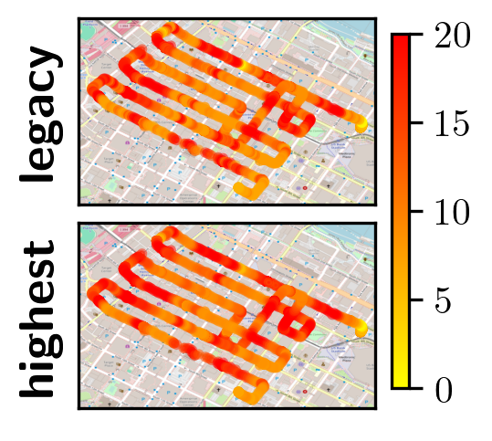
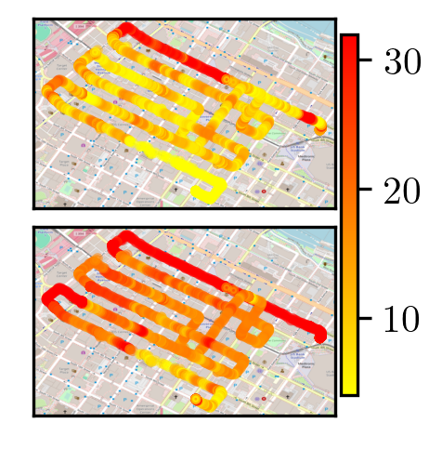
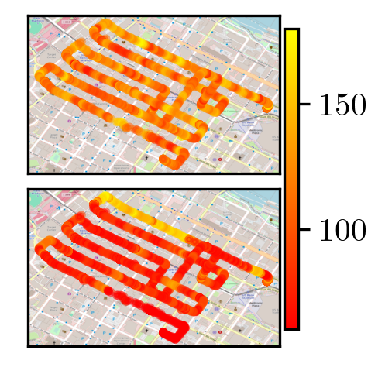
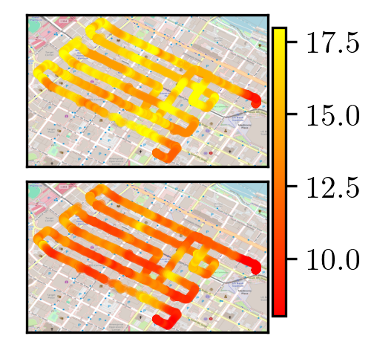

Issues with Legacy CM Procedures
Signal Quality
Video Bitrate
Per-frame Latency
Energy Efficiency
Performance-oblivious criteria results in missed gains
The legacy design is network centric
Notes:
Now, we saw several issues in the legacy CM procedures we just discussed. To quantify how much these issues matter in practice, we conducted a measurement study on a university campus and compared legacy CM policies against the optimal cell combination that delivers the highest performance at each location
First, when we look at signal quality, legacy CM and the optimal choice look very similar. That’s expected because legacy CM is designed around link strength. On this heatmap, dark red indicates higher link quality and the two align closely.
[click] But when we switch from link quality to a throughput metric like video bitrate, the picture changes dramatically. Here the optimal choice is often much better than what legacy CM selects.
[click] latency and energy efficiency convey a similar story, leaving substantial performance gains on the table
[click] And beyond that, legacy CM is fundamentally network-centric. The network enforces one-size-fits-all rule set, so it cannot tailor cell combinations to the differing UE performance needs that a VR headset and a smartwatch have
[click]

Slide 10
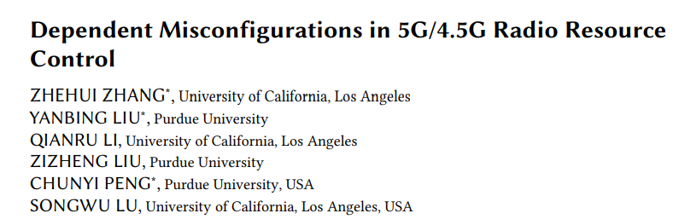
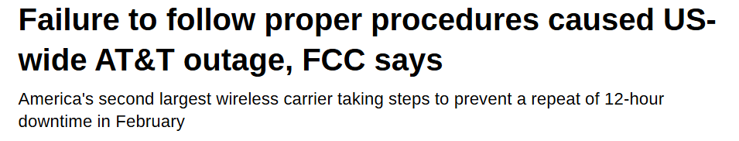

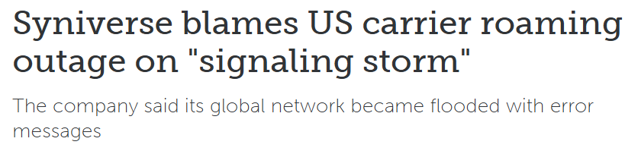
Issues with Legacy CM Procedures
Independent CM procedures lead to increased management complexity, misconfigurations and outages!
Notes:
[click] Beyond just poor performance, these CM procedures work independently of each other, and that creates massive management complexity.
[click] We've seen major headlines where misconfigurations in these fragmented procedures caused massive network outages for carrier operators.

Slide 11

Performance-driven Connectivity Management through Abstraction!
Criteria
Link Quality
Throughput
Latency
Energy
ML Reward
Actions
(UE’s perspective)
Add Cell
Modify Cell
Remove Cell
CM Procedures
Handover
Cell Re/selection
CA/DC
Load Balancing
Notes:
To solve this, we propose Performance-driven Connectivity Management, or OPCM. Our key idea is to step back and introduce a clean abstraction layer.
[click] If you look at CM procedures, you will notice that all of them [click] are essentially taking one of the three key actions from UE’s perspective. They either add a new cell, remove a cell, or modify a cell.
[click] And they mainly do that using link quality criterion.
Instead of hard-wiring decision logic into each CM procedure, we can make these concepts modular and separate what we care about — the performance criteria — from how the network acts — the specific action it takes.
[click] We can also add other performance metrics like throughput or ML reward as a criterion to this to further optimize it for the application.
[click]

Slide 12
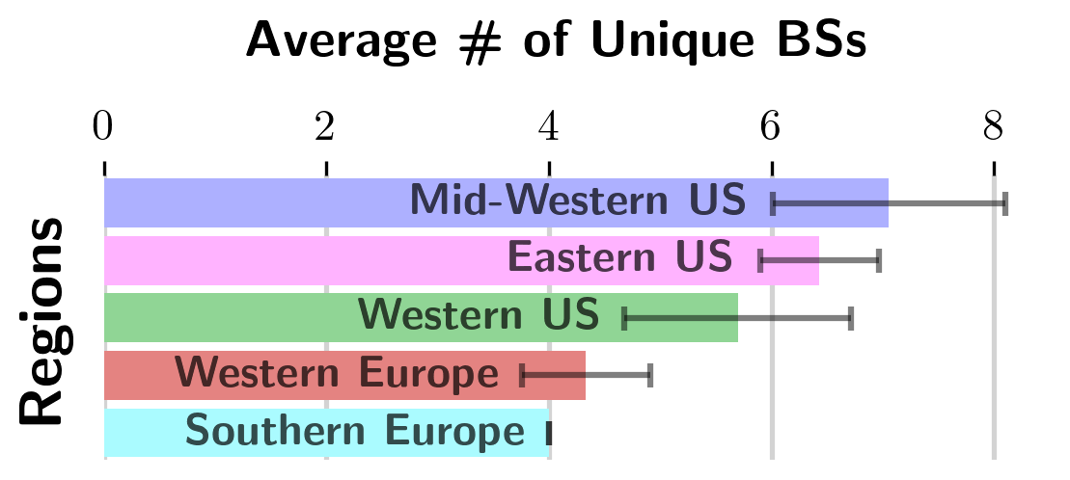
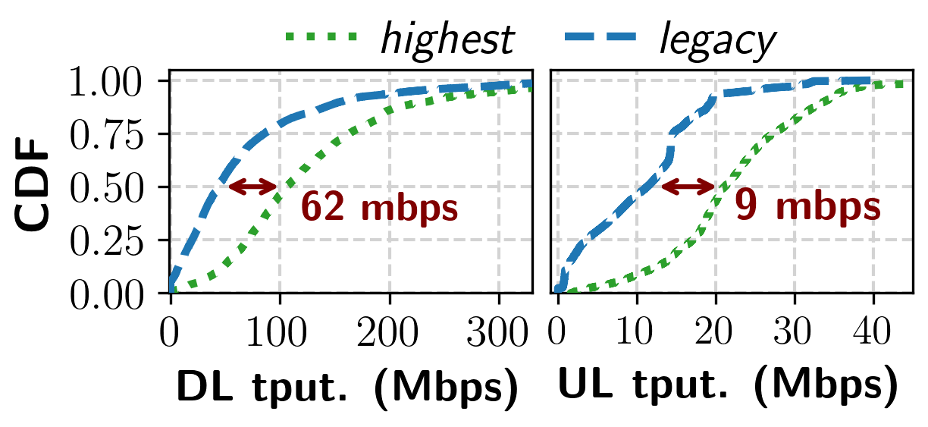
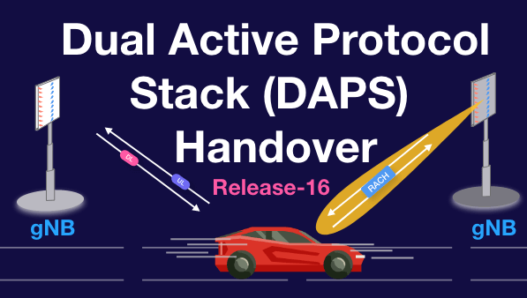
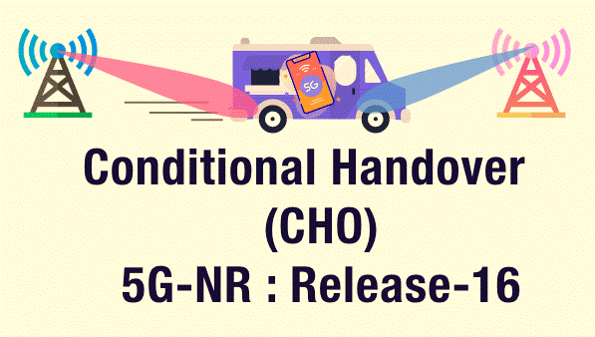
Rationale for Performance-driven Connectivity Management
7+ unique cell combinations in median case
up to 70% performance boost is possible
Wide availability and heterogeneity of cell deployments
Untapped performance gains
Recent shift in trends (smarter connectivity management)
Notes:
Now, the motivation for proposing something like OPCM comes from three observations based, grounded in measurements
[click] First, our multi-country measurements show that modern networks offer wide availability and heterogeneity of cell deployments
[click] Second, we find that there are untapped performance gains left in the network that can be utilized.
[click] And third, the ecosystem is already moving toward CM procedures that aim to improve device-level performance, which makes the timing right for a more systematic approach.
OPCM takes all these trends seriously and tries to systematically use them to its advantage
[click]

Slide 13
Comparison of existing CM schemes and OPCM
Features |  | Legacy | iCellSpeed | Ours
Supports Performance Metric | Link Quality | ✔ | ✔ | ✔
 | Throughput | ✖ | ✔ | ✔
 | Latency | ✖ | ✖ | ✔
 | Energy | ✖ | ✖ | ✔
Fair to other UEs |  | ✔ | ✖ | ✔
Respects RAN policies |  | ✔ | ✖ | ✔
Is 3GPP compliant |  | ✔ | ✖ | ✔
“iCellSpeed: increasing cellular data speed with device-assisted cell selection” In Mobicom’20
Notes:
Here’s a table to preview what’s coming and to show how our approach compares with legacy CM and with iCellSpeed, a UE-side method that boosts data speed.
Legacy CM is stable and well-established, but it focuses entirely on link quality, not allowing for other performance criteria.
iCellSpeed does improve throughput, but it doesn’t address energy or latency and it bypasses operator fairness considerations.
Our system checks all the boxes: It supports all performance metrics, ensures Fairness, respects operator Policies, and stays fully 3GPP-compliant, which is the standards body that defines how cellular networks operate.

Slide 14




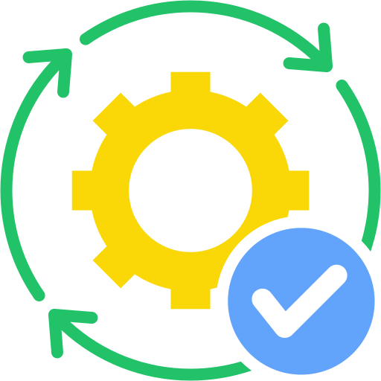

A typical CM Procedure
1. configure
measurements
4. decide cell(s) to add/modify/remove
2. measure
signal quality
5. execute CM procedure
3. report
measurements
Notes:
Before we get into our solution, let’s quickly walk through what a typical CM procedure looks like. Not every procedure follows this flow exactly, but this is the pattern you’ll see most often.
[click] First, the serving base station tells the UE which neighboring cells it should measure.
[click] The UE then measures the signal quality for those cells.
[click] When the UE is actively connected, it sends those measurements back to the base station.
[click] Using that information, either the base station or the UE decides which cells should be added, removed, or updated.
[click] And finally, the relevant CM procedure is carried out.
[click]

Slide 15
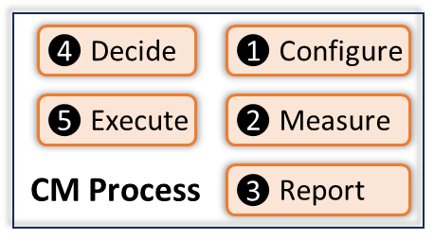
Opportunistic Performance-driven Connectivity Management (OPCM)
Profiling Engine
Decision Framework
Data Manager
Execution Module
Notes:
We design OPCM to opportunistically select the best cell combination for each UE, without causing any performance degradation.
[click] It runs on the base station side and remains fully standards-compliant.
[click] Within the typical CM process, we only —
[click] replace the “decide” stage with our decision framework, [click] and replace the “execute” stage with our execution module.
[click] We also introduce a profiling engine that estimates the performance of different cell combinations.
[click] And finally, a data manager that logs measurements at the base station and feeds them into the profiling engine.
We will now discuss the key aspects of OPCM.
[click]

Slide 16
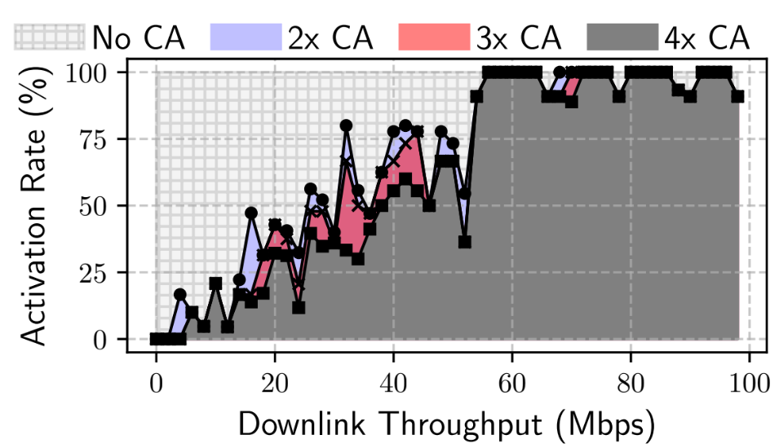
Cell Set Generation
cells are not aggregated incrementally
Cell combinations → Cell Set C = {c^{i}}
E.g., c¹ = [4G 1935MHz PCell, 5G 2510MHz SCell, 5G 2530MHz SCell]
Problem: 100+ possible cell combinations
Insight: Operators do not allow all combinations in the wild
Solution: Only allow feasible cell combinations based on history in C
Notes:
Now let’s dig into the Decision Framework. The first step is identifying a feasible set of cell combinations for each UE.
[click] A user may be surrounded by many cells, which can explode into more than a hundred possible combinations — far too many to profile directly.
[click] But our measurements show that operators don’t activate combinations arbitrarily. They rely on a limited amount of allowed sets, added in as groups.
[click] So OPCM leverages this insight and narrows the cell set to only those combinations.
[click]

Slide 17
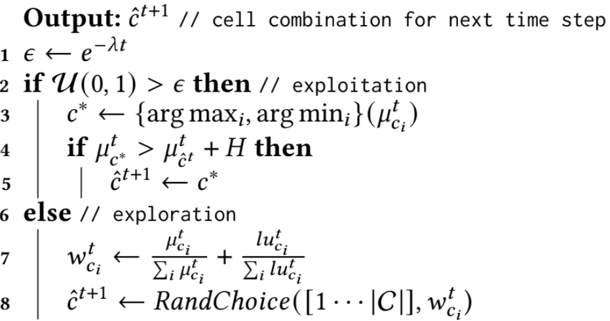
Opportunistic Decision Making
Problem: UEs can only use one cell combination at a time
decide whether to use current cell combination or choose another
Challenge: Exploration vs. Exploitation
Solution: Epsilon-greedy policy
Gain-aware greedy exploitation
Smart random exploration
Notes:
Now that we have a feasible set, the next step is deciding which cell combination the UE should actually use.
[click] The core challenge here is balancing exploration and exploitation — do we rely on our current estimates and pick the best option, or explore other combinations to improve those estimates?
[click] To handle that tradeoff, we use an epsilon-greedy policy. [click] Most of the time, we exploit: we stick with the current choice or switch to a better one when the expected gains are meaningful.
[click] Other times, we use a smart random exploration strategy that prioritizes combinations with good historical performance and those we haven’t explored in a while.
[click]

Slide 18
Opportunistic Performance-driven Connectivity Management (OPCM)
Profiling Engine
Decision Framework
Cell set generation
Cell set pruning
Opportunistic decision making
Data Manager
Execution Module
Notes:
[click] So all together, the decision framework first builds a feasible set of cell combinations.
[click] Then it prunes that set to ensure we respect RAN policies such as fairness and load balancing.
[click] And finally, it balances exploration and exploitation to select the cell combination for the next cycle.
[click]

Slide 19
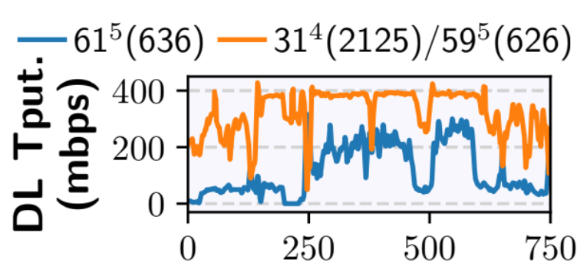
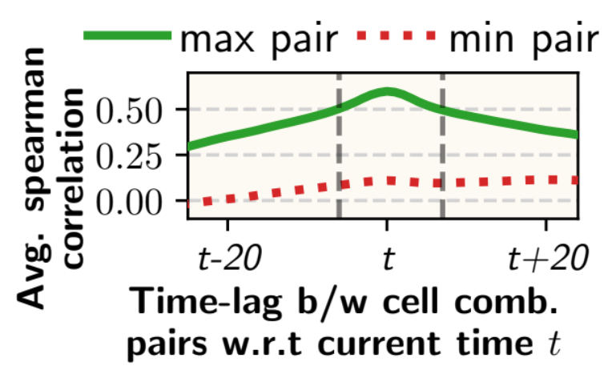
Passive Performance Approximation
Problem: Absence of inactive cell combination’s network performance data
Insight: Performance can have cross-correlation across cell combinations
Solution: Leverage active cell combination’s performance data to improve inactive cell combination’s performance estimate
Notes:
Let’s take a quick look at the design of the profiling engine. Since we can’t constantly switch the UE across all cell combinations just to measure performance—that would severely hurt the user experience—we rely on Passive Approximation whenever possible.
[click] We’ve observed that many cell combinations show cross-correlation in their performance. In this graph, for example, when the throughput of the blue combination drops, the orange one often follows a similar pattern. This can happen for several reasons: shared congestion, cells mounted on the same tower, or even user-side blockage.
[click] So by computing the Time-Lagged Cross-Correlation, or TLCC, we can often estimate the performance of inactive combinations based on the active one—without needing to switch at all.
[click]

Slide 20
Opportunistic Performance-driven Connectivity Management (OPCM)
Profiling Engine
Decision Framework
Criteria Support
Cell set generation
Passive Approximation
Cell set pruning
Lightweight Performance Estimation
Opportunistic decision making
Data Manager
Execution Module
Notes:
[click] To put it simply, the profiling engine can passively approximate the performance of inactive cell combinations whenever that correlation exists. [click] It also supports multiple performance metrics as criteria, and even allows custom metrics through our API. [click] And finally, it uses a simple filter-based method to generate predictions from historical performance estimates. [click]

Slide 21

Delayed Reconfiguration
Problem: CM procedures incur data plane interruptions
Observation: It happens when data is waiting in the uplink or downlink transmission queues
Solution: Delay CM in anticipation that queues will drain up soon
data forwarding
Notes:
And finally, we have the execution module. Now the problem is that CM procedures can sometimes interrupt data
[click] These interruptions typically happen when data is still sitting in the uplink or downlink queues,
[click] and that data has to be forwarded only after the procedure completes.
[click] so we just delay CM by a few milliseconds sometimes, , giving the queues a chance to drain. If not, we execute the switch anyway.
[click]

Slide 22
Opportunistic Performance-driven Connectivity Management (OPCM)
Profiling Engine
Decision Framework
Criteria Support
Cell set generation
Passive Approximation
Cell set pruning
Lightweight Performance Estimation
Opportunistic decision making
Data Manager
Execution Module
Delayed Reconfiguration
Fallback Mechanism
Notes:
[click] To summarize, the execution module has delayed reconfiguration, and
[click] there’s a fallback mechanism to go to the legacy link quality-based criterion if the data activity is really low.
[click]

Slide 23


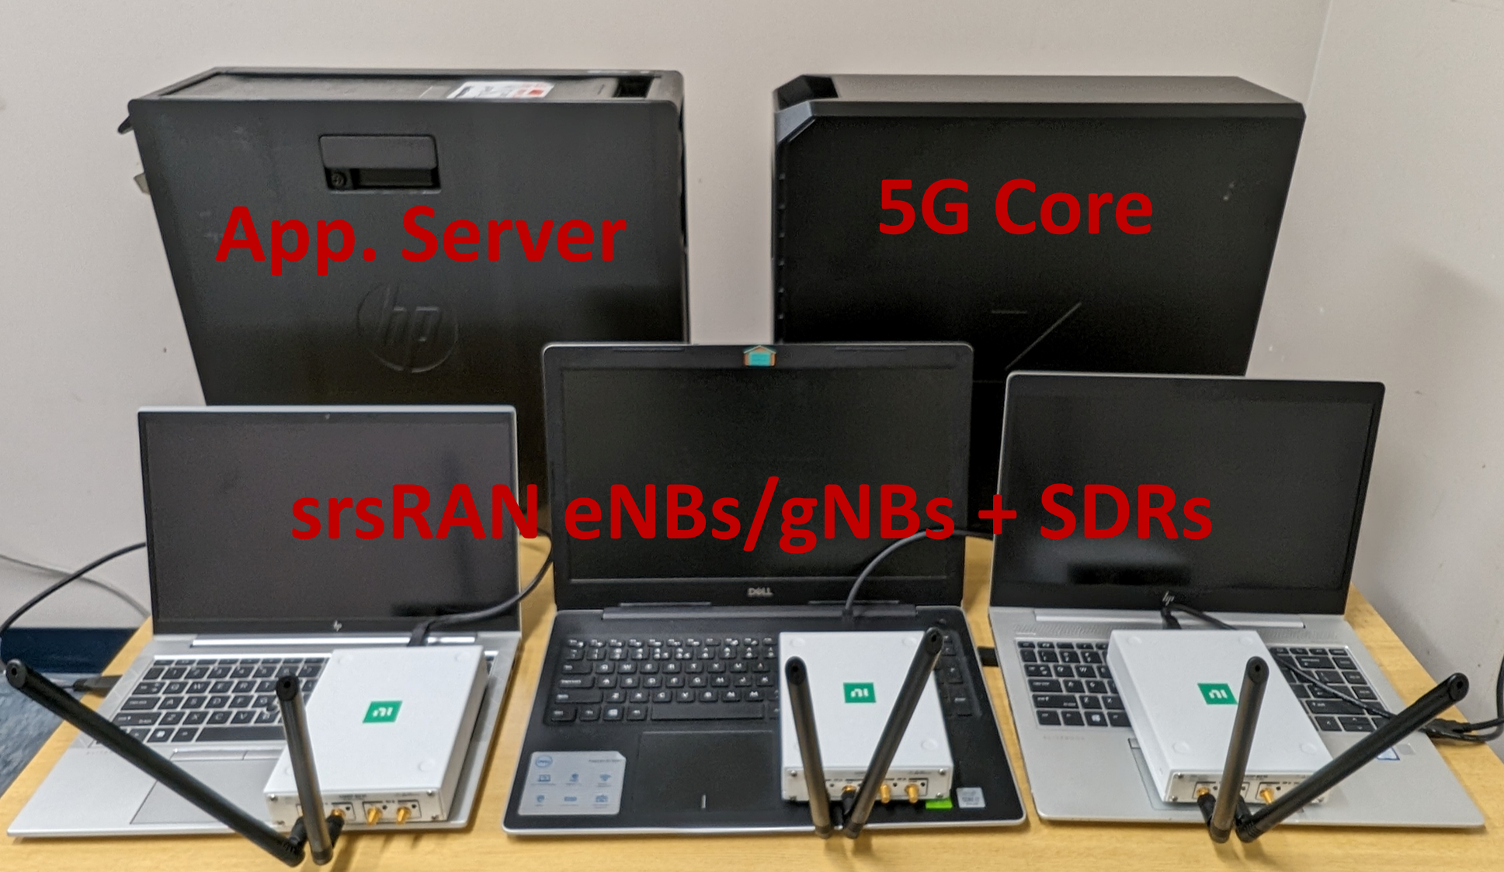





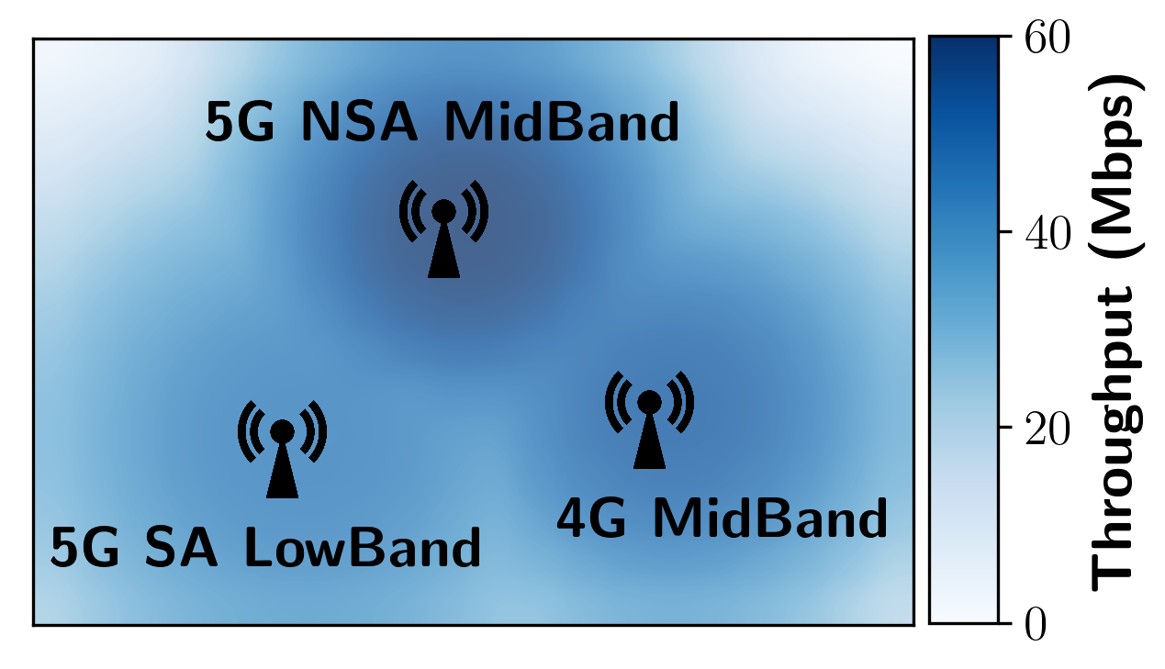
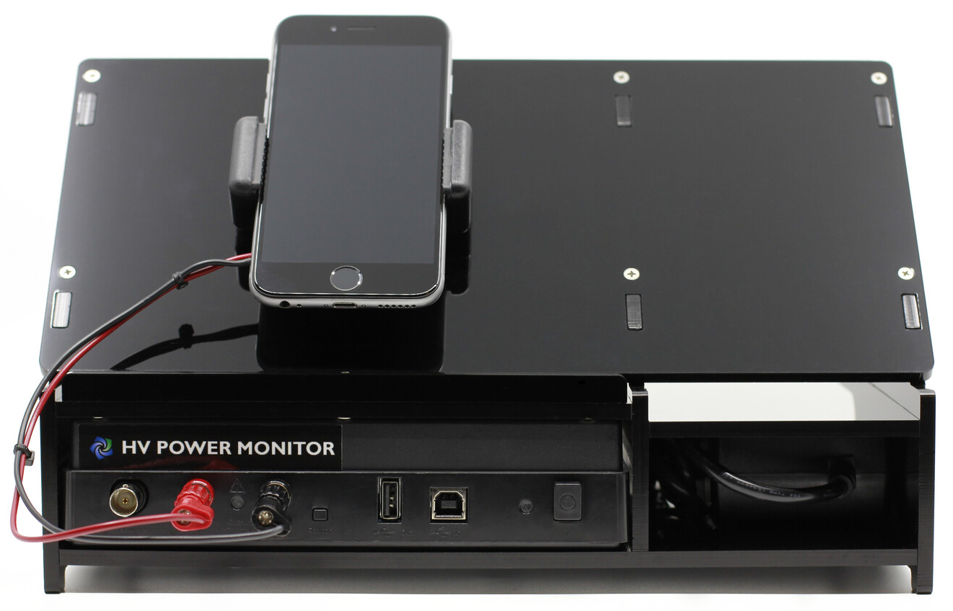


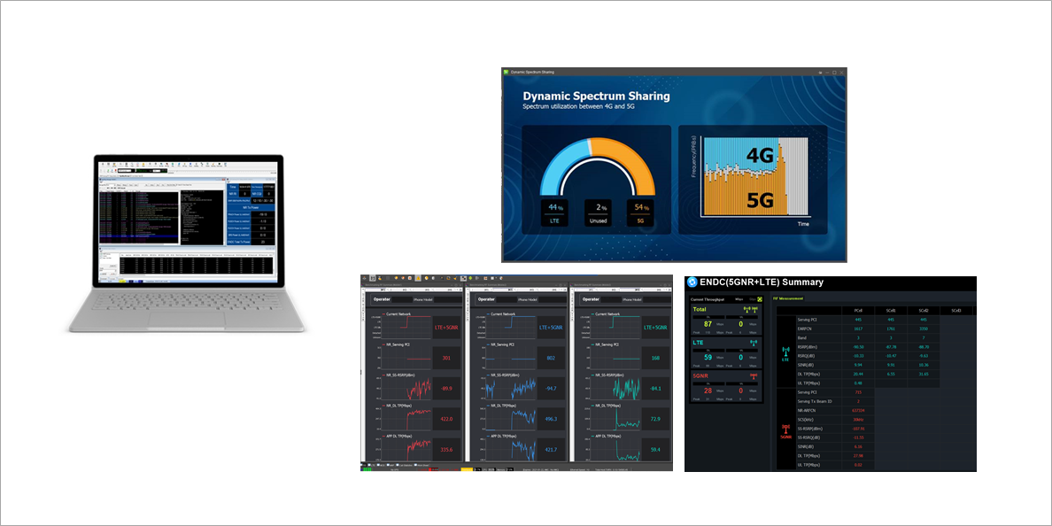
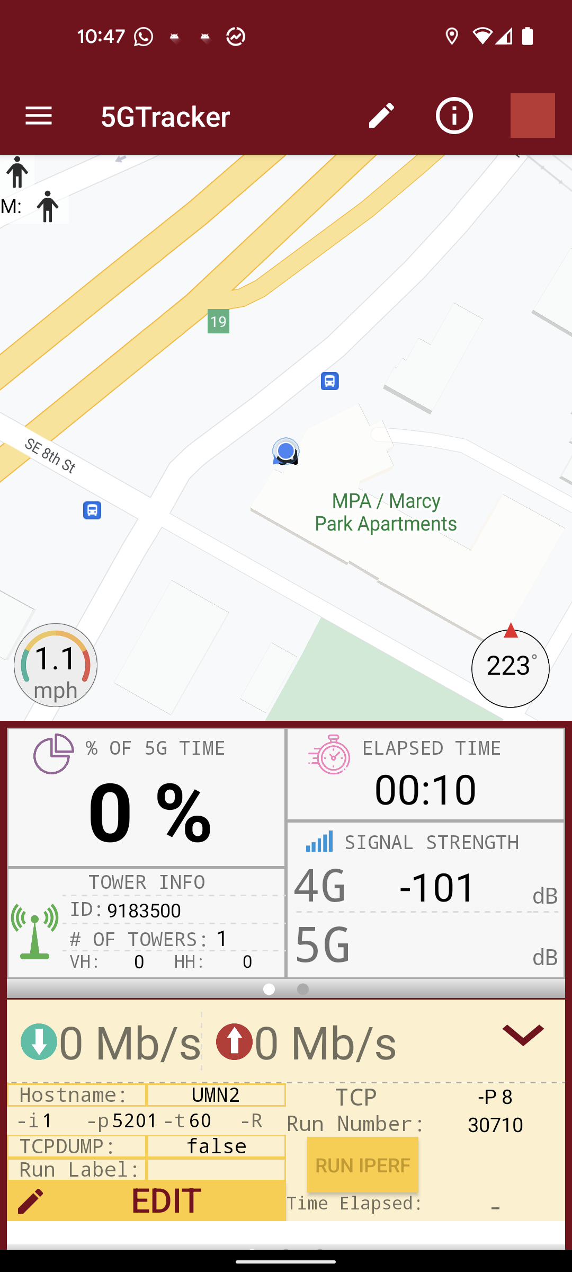
Evaluation Setup
Over-the-air Testbed
Live 5G Experiments
Trace-driven Simulations
Advanced numerologies & configurations
Power Monitor
XCAL
S22+
Notes:
We evaluated OPCM extensively.
[click] First, we built an over-the-air testbed using software-defined radios and a srsRAN stack to create a real 5G network.
[click] We then used trace-driven simulations to scale up to hundreds of users, driven by real-world traces we collected.
[click] And finally, we ran experiments on commercial 5G networks whenever possible.
[click]

Slide 24
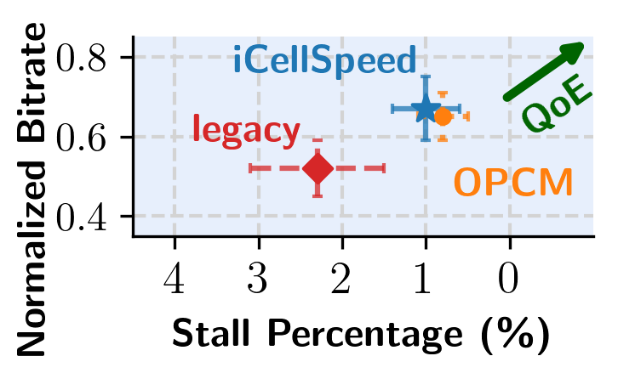
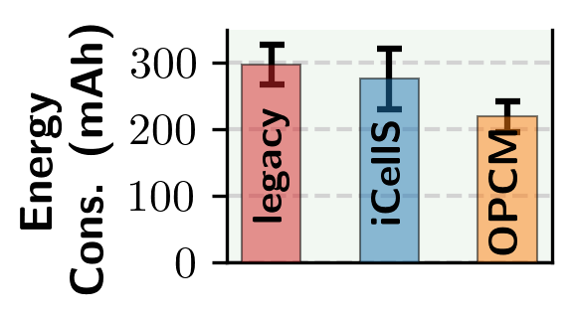
OPCM QoE Improvement
Video On-demand Streaming
Fitness Tracking Application
Over-the-air Testbed
26.3% and 20.6% lower energy consumption than legacy and iCellSpeed
25.1% better average bitrate than legacy,
and 65.2% lower stall rate
“iCellSpeed: increasing cellular data speed with device-assisted cell selection” In Mobicom’20
Notes:
The results are quite promising.
[click] In video-on demand tests, OPCM delivered a 25.1% higher bitrate and reduced stalls by 65.2% compared to legacy CM.
[click] For IoT and fitness applications that only send small amounts of data occasionally, OPCM cut energy consumption by over 26% by choosing more energy-efficient cell combinations.
[click]

Slide 25
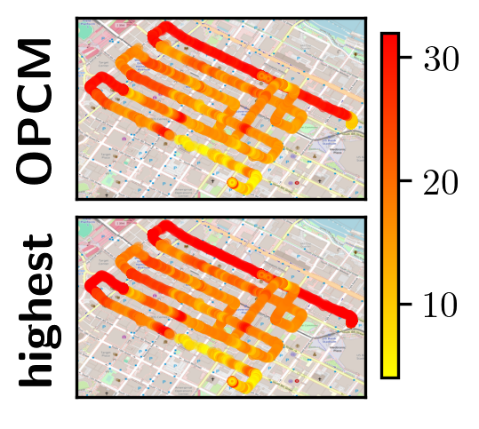
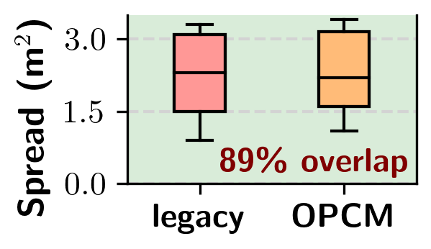
System Benchmarking
Over-the-air Testbed & Simulations
Live 5G Experiments
Video Bitrate
OPCM is backward-compatible, and performs as well as the legacy CM under mobility
OPCM’s epsilon-greedy policy works effectively in the real world
Notes:
Another key point is that OPCM is safe to deploy.
[click] When we compared it with legacy protocols, we found it to be fully backward-compatible. Under mobility, it triggers handovers in essentially the same places as legacy CM when configured to follow link-quality rules.
[click] And our epsilon-greedy policy converges quickly. In dynamic environments, it gets within about 10% of the theoretical best cell combination. In these plots, you can clearly see how OPCM separates from legacy while staying close to the highest possible option.
[click]

Slide 26

Opportunistic Performance-driven Connectivity Management (OPCM)
Large-scale Measurement Study
System Design & Implementation
E2E Evaluations & Micro-benchmarking
Spatial and temporal availability of cell deployments
Performance diversity of cell deployments in the wild
Performance gains left on the table by legacy CM
Balance explore vs. exploit tradeoff due to limited knowledge
Leverage cross-correlation across cell combinations
Delay reconfiguration to minimize data interruptions
QoE improvement for users
Backward compatibility and performance under mobility
Fair and respects RAN policy
Scalable with minimal communication overhead and system costs
Scan me!
Questions?
Reach out to ahmadhas@usc.edu for further questions.
Notes:
So to wrap up everything we’ve covered today:
[click] We began with a large-scale measurement study, which revealed the significant opportunity for performance-driven connectivity management.
[click] We then designed and implemented OPCM across both our over-the-air testbed and large-scale simulations, grounding it in practical, standards-compliant mechanisms.
[click] And finally, we evaluated it extensively across multiple scenarios and applications, showing consistent improvements in the quality of experience , efficiency, and deployment safety.
[click] Thank you, and now the authors of the paper will join us via zoom for any questions.

